Slide 1
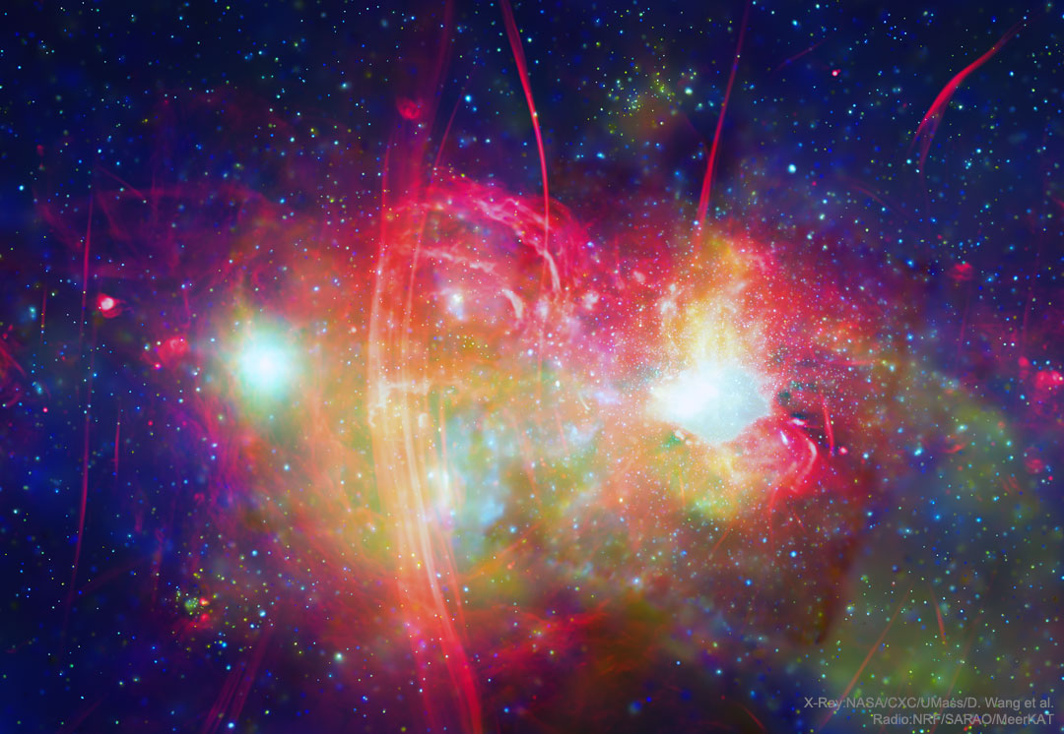
Unmasking Black Holes Using AI
ISP Group B: Jaime Pryor,Raymond Shao & Yunki Yau
NASA Astronomy Picture of the Day March 31 2020 – The Galactic Centre from Radio to X-Ray. https://apod.nasa.gov/apod/ap200331.html

Slide 2
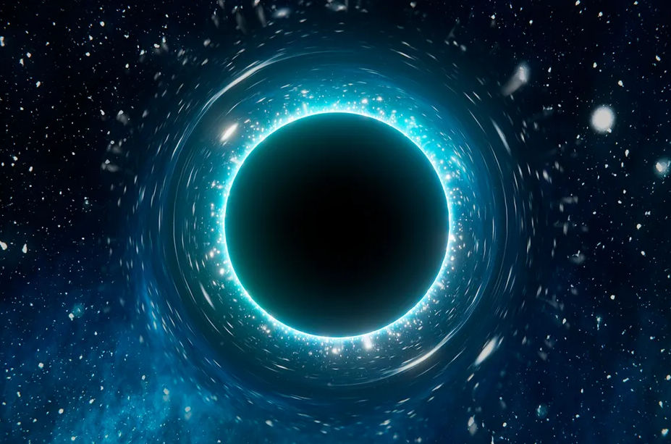
Black Hole
Gravitational lensing distorts light from surrounding stars
A Solo Wandering Black Hole, Lintott C. 2025, Astronomers may have found a solo black hole wandering through space: https://www.skyatnightmagazine.com/space-science/solo-wandering-black-hole

Slide 3
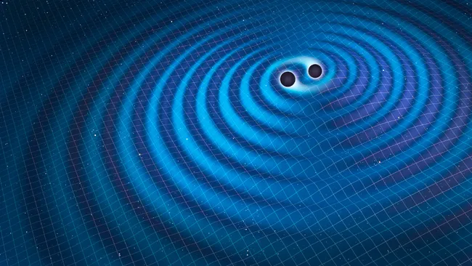

Existing Approaches to Detecting Black Holes
Two black holes merging and creating gravitational waves. Mark Garlick/Science Photo Library via Getty Images
An example Convolutional Neural Network Architecture. Phung, & Rhee,. (2019). A High-Accuracy Model Average Ensemble of Convolutional Neural Networks for Classification of Cloud Image Patches on Small Datasets. Applied Sciences. 9. 4500. 10.3390/app9214500.
1. Obtain signals from gravitational waves produced by black hole mergers.
2. Train a machine learning model or neural network on this data.
3. Test machine learning model or neural network on new data.

Slide 4
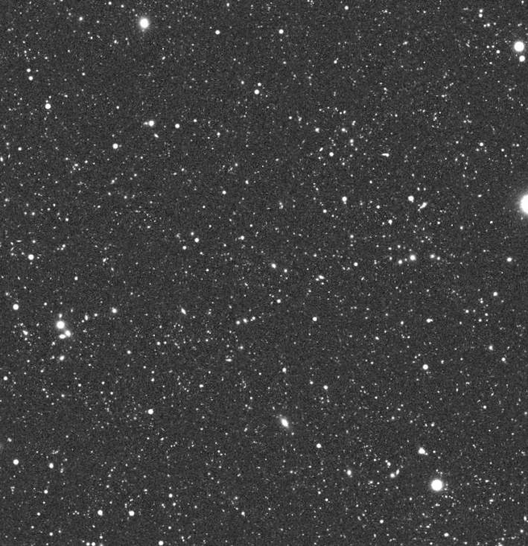

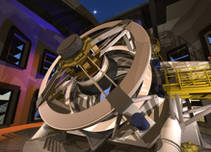
Existing Approaches to Detecting Black Holes
An annoyed PHD researcher obtained from OpenAI. (2024). ChatGPT (August 28th GPT-4) [Large language model]. https://chat.openai.com
An artist’s render of the Rubin telescope. Mason T. , “Close-up of Telescope in the Dome”, uploaded on 2017 to: https://gallery.lsst.org/bp/#/folder/2334406/51647473
DP0.2 Simulation of a Rubin Observator Image - Provided by David Sweeney, USYD
2. Many noisy images are obtained.
3. Researchers have to observe and identify the possible signs of black holes.
1. Ground based telescope scans the entire night sky.

Slide 5
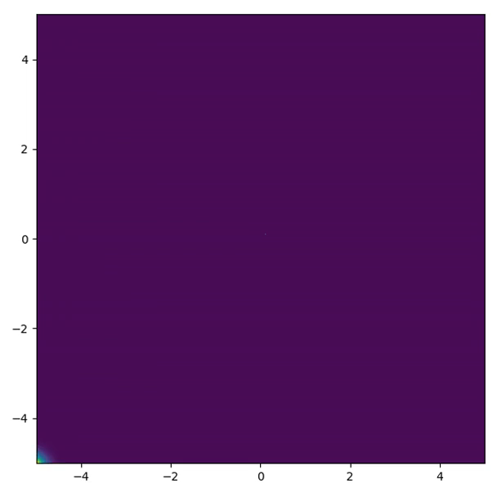
Our Idea
AI 🧠
?
DP0.2 Simulation of a Rubin Observator Image - Provided by Prof. Geraint Lewis, USYD
Notes:
Add in different images over time.

Slide 6
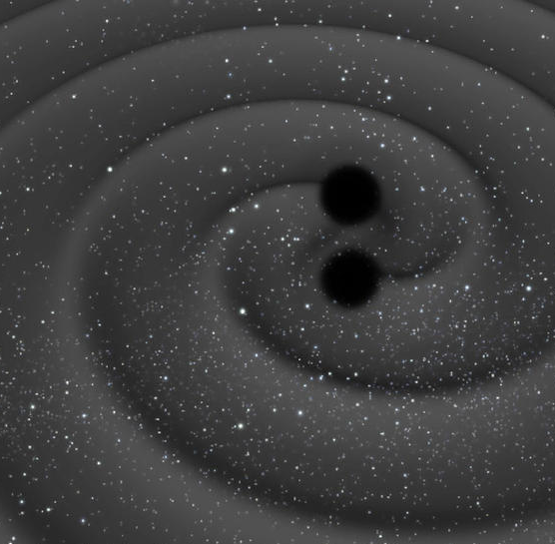
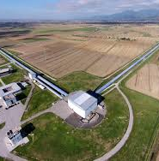
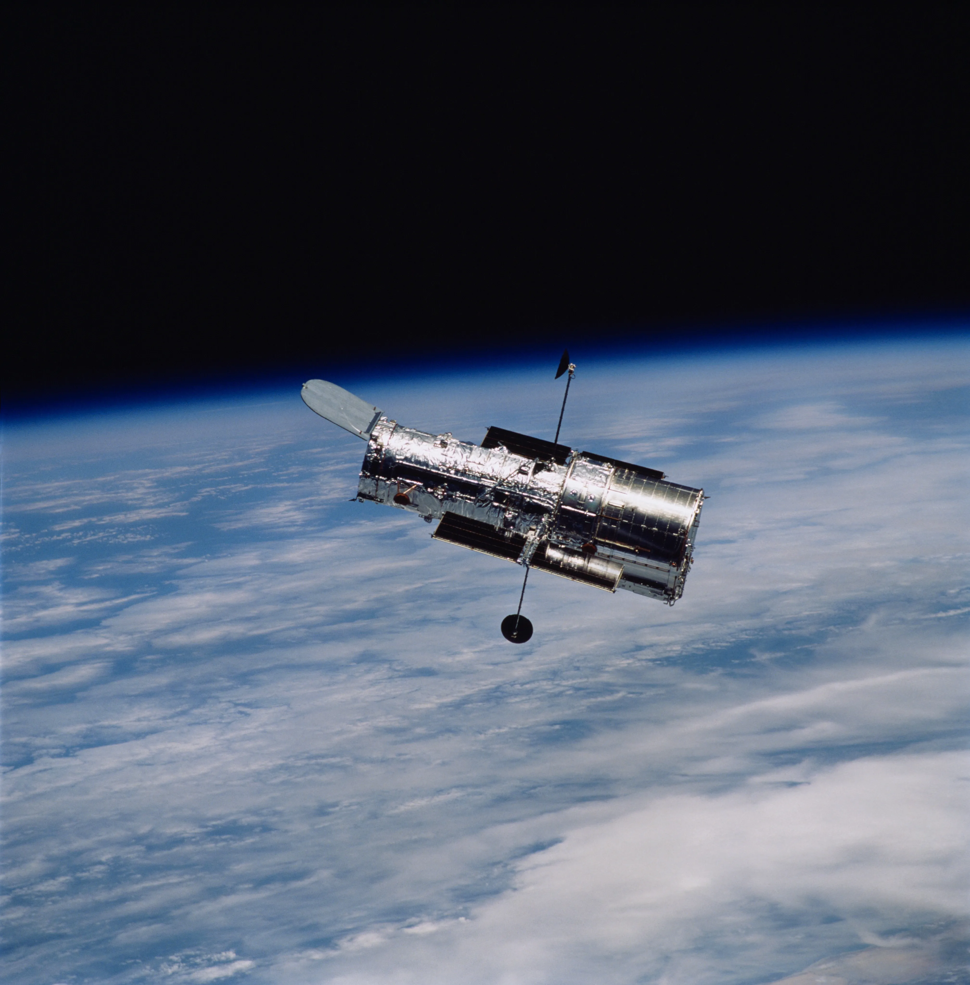
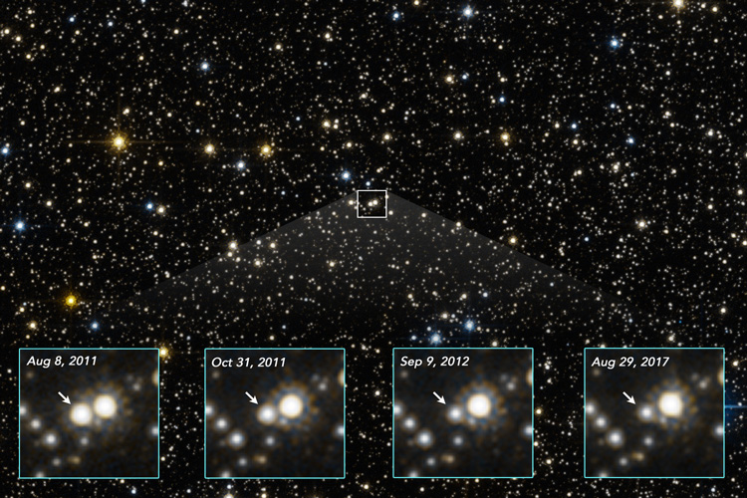
What’s new about it?
Doesn’t need binary interactions, useful for isolated black holes
Artistic representation of black hole merger, C. Carreau/European Space Agency, CNRS News
Aerial view of Virgo, The Virgo Collaboration, The Virgo Collaboration
Uses ground-based observation and is less resource-intensive
Hubble Space Telescope, NASA Science
Hubble Space Telescope photo showing one (center) that brightened and dimmed between 2011 and 2017, NASA, ESA, Kailash Sahu, Joseph DePasquale, UC Berkeley News
Notes:
Images (top to bottom, left to right): CNRS News
The Virgo Collaboration
NASA Science UC Berkeley News

Slide 7
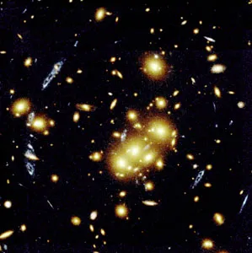
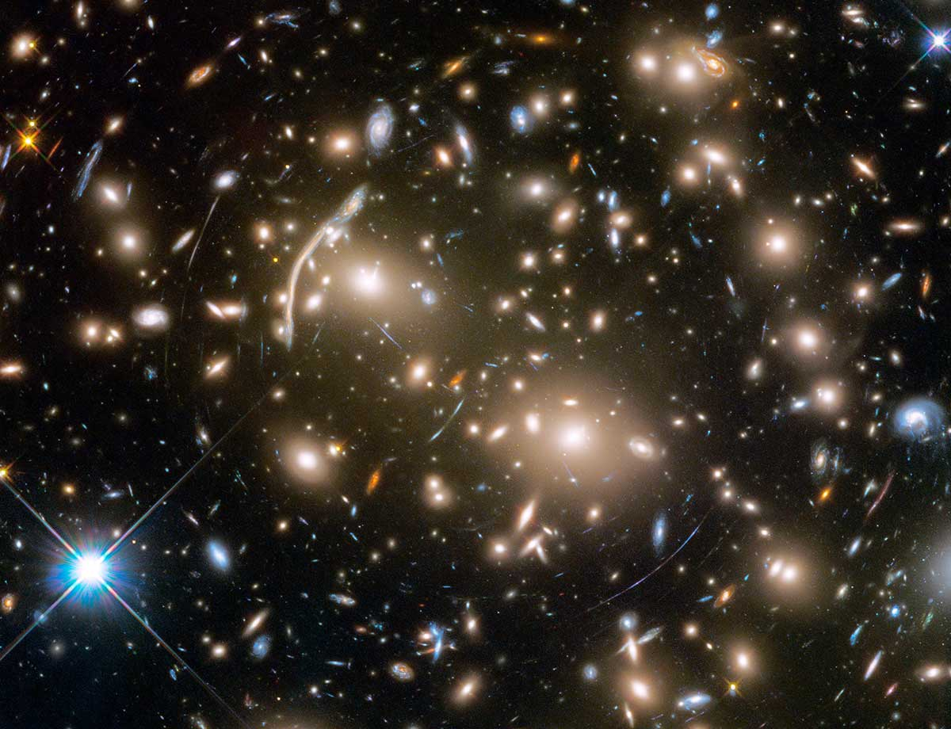
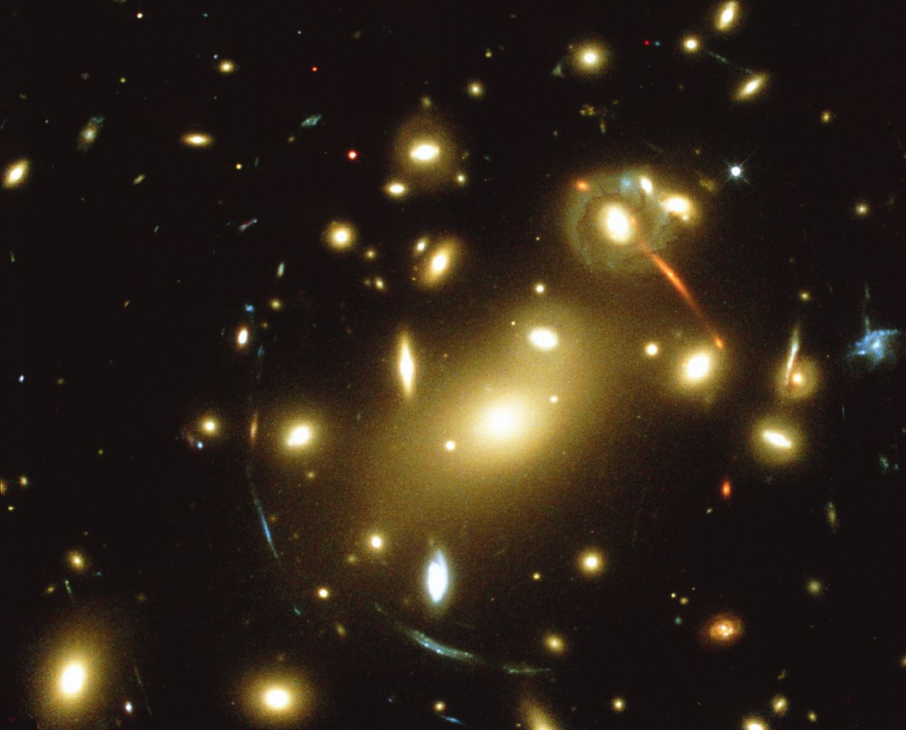
What difference will it make?
Observations of black holes are important for understanding outstanding questions in stellar evolution (Lam 2022)
To date, most of the local population of black holes has not been experimentally confirmed and characterised
Images Top to Bottom: Gravitational Lens Britannica; Galaxy cluster Abell 370 NASA, ESA, and J. Lotz and the HFF Team (STScI) News Release: 2017-20, HubbleSite; Gravitational lens, Britannica
Notes:
Images (top to bottom): Britannica HubbleSite
Britannica

Slide 8
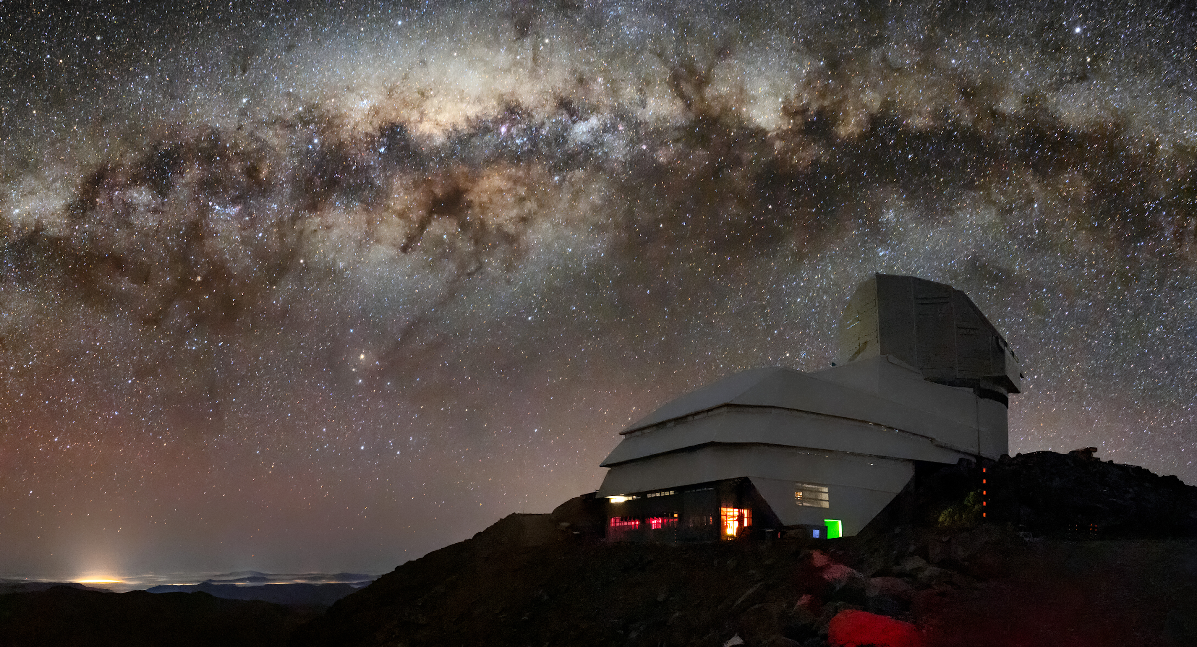
Phase I – Proof of Concept
We will develop an algorithm that can model the effect of gravitational microlensing on ground-based telescope images
The Vera C. Rubin Observatory and the Milky Way, Cerro Pachón, Chile. https://noirlab.edu/public/images/iotw2207a/
Notes:
We’ve identified two primary phases to make our idea a reality. The first is to establish technical proof by developing an algorithm that is able to model the effects of gravitational microlensing on ground-based telescope images, such as ones that will come from the Rubin Observatory in Chile, which will photograph the entire available sky every three nights.
From there, we can then use our model to run simulations over a library of telescope images to develop a training dataset to build our AI model.
(Potential question – the ground-based images we get will already be lensed, so if you lens these images, you will lens them twice won’t you?
Answer: We are not interested in lensing occurring in deep space. We want to detect black holes that are close by - <1kpc, which we will observe to move over the static picture we have of deep space and background stars)

Slide 9
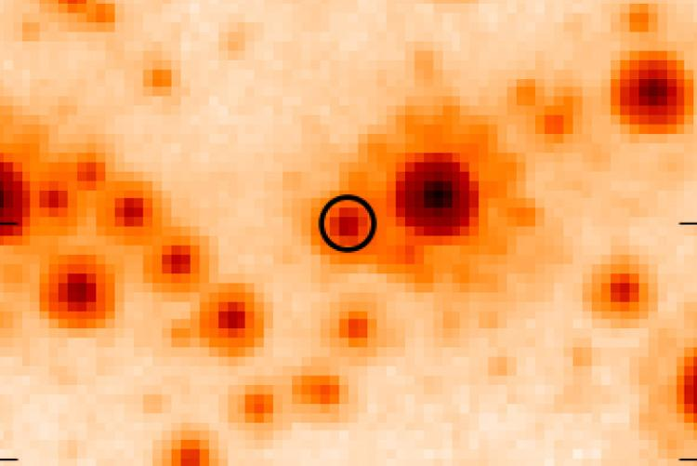
Phase 2 – Demonstration of Functionality
We will apply our AI model to observatory images at the time of the OB110462 microlensing event to determine if we can positively identify it.
Hubble Space Telescope image of OB110462. Lam et al, 2022. An Isolated Mass-gap Black Hole or Neutron Star Detected with Astrometric Microlensing, The Astrophysical Journal Letters
Notes:
In the second phase, we will aim to demonstrate the functionality of our AI model by applying it to observatory images at the time of the only known isolated black hole microlensing event that we previously mentioned, which is called OB110462.
Having established our ability to identify this true positive, we will then apply our model to a priori telescope images to identify candidate microlensing events, and use secondary sources such as Hubble and interferometer data to verify any candidate black holes our program picks up.
(Actually OGLE (Optical Gravitational Lensing Experiment) in Poland and MOA (Microlensing Observations in Astrophysics) NZ, Japan picked it up simultaneously on June 2, 2011, before HST was used.
(Potentially from wide-field surveys such as the Zwicky Transient Facility or Pan-STARRS (Hawaii) that can observe the galactic bulge, where the event occurred).

Slide 10
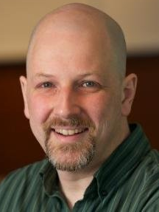
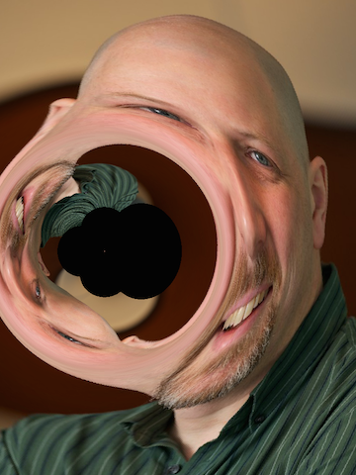
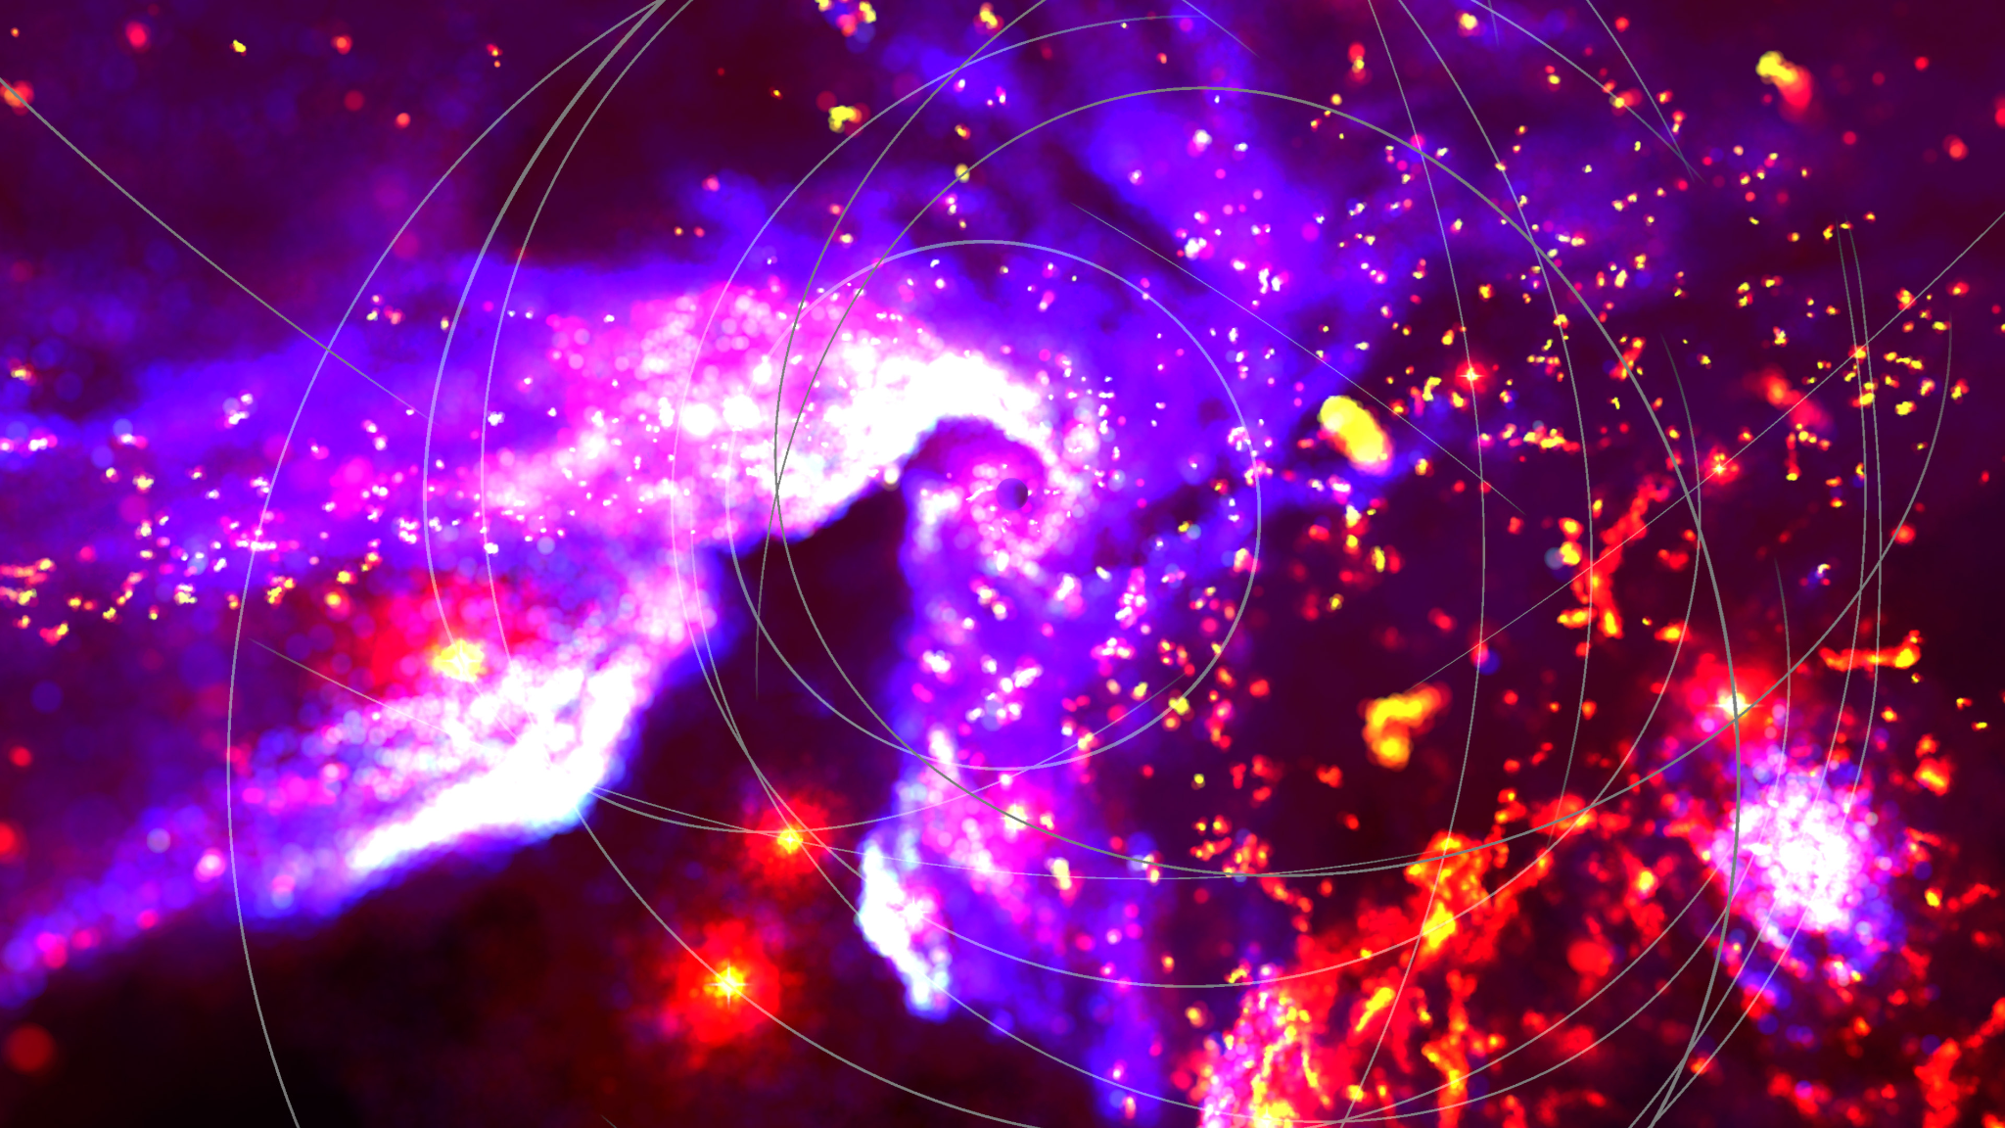
The Plan
VR Galactic Centre, Christopher Russell, University of Delaware & Catholic University of America. https://www.nas.nasa.gov/SC21/research/project30.html
Gravitational lensing effect on a picture of Prof. Mike Hudson, University of Waterloo, https://uwaterloo.ca/scholar/mjhudson
DP0.2 Simulation of a Rubin Observator Image - Provided by David Sweeney, USYD
Step 3 (Week 12 & beyond):
Perform testing of our model on telescope images to build an AI training dataset
Step 1 (Week 6 - 8):
Establish a gravitational lensing algorithm that can be applied to an image
Step 2 (Week 9 - 11):
Research, obtain and process appropriate (real or simulated) telescope images to which we can apply our model
Notes:
Our plan over the next eight weeks, is to get our algorithm to the place of being able to build a dataset to train a machine learning model, and we’ve broken up this goal into 3 blocks:
We will first build a gravitational microlensing process that can be applied to images, which we are currently working on, then we will determine and obtain the most appropriate telescope images to apply our model, and by the end of the semester we aim to be able to test our algorithm on these images for a variety of different parameters and start assembling a training dataset from which we can build an AI model.
(Week 6-8 challenges: be able to assign the right discrete pixel to create a ‘correct’ microlensed image, taking into consideration rounding effects that will occur from the lens equation.
(Week 7-9 challenges: finding appropriate telescope images to use, normalising and resizing these images, mapping a meshgrid onto a detailed telescope image,
(Week 12-13 challenges: testing that our algorithm works at different source-to-lens and lens-to-observer distances, then using the lensed images as a training dataset to build an AI model. The unique challenge is that we don’t have ‘true positive’ validation data (telescope images in which we know there is a microlensing event) to evaluate how good our model is.

Slide 11
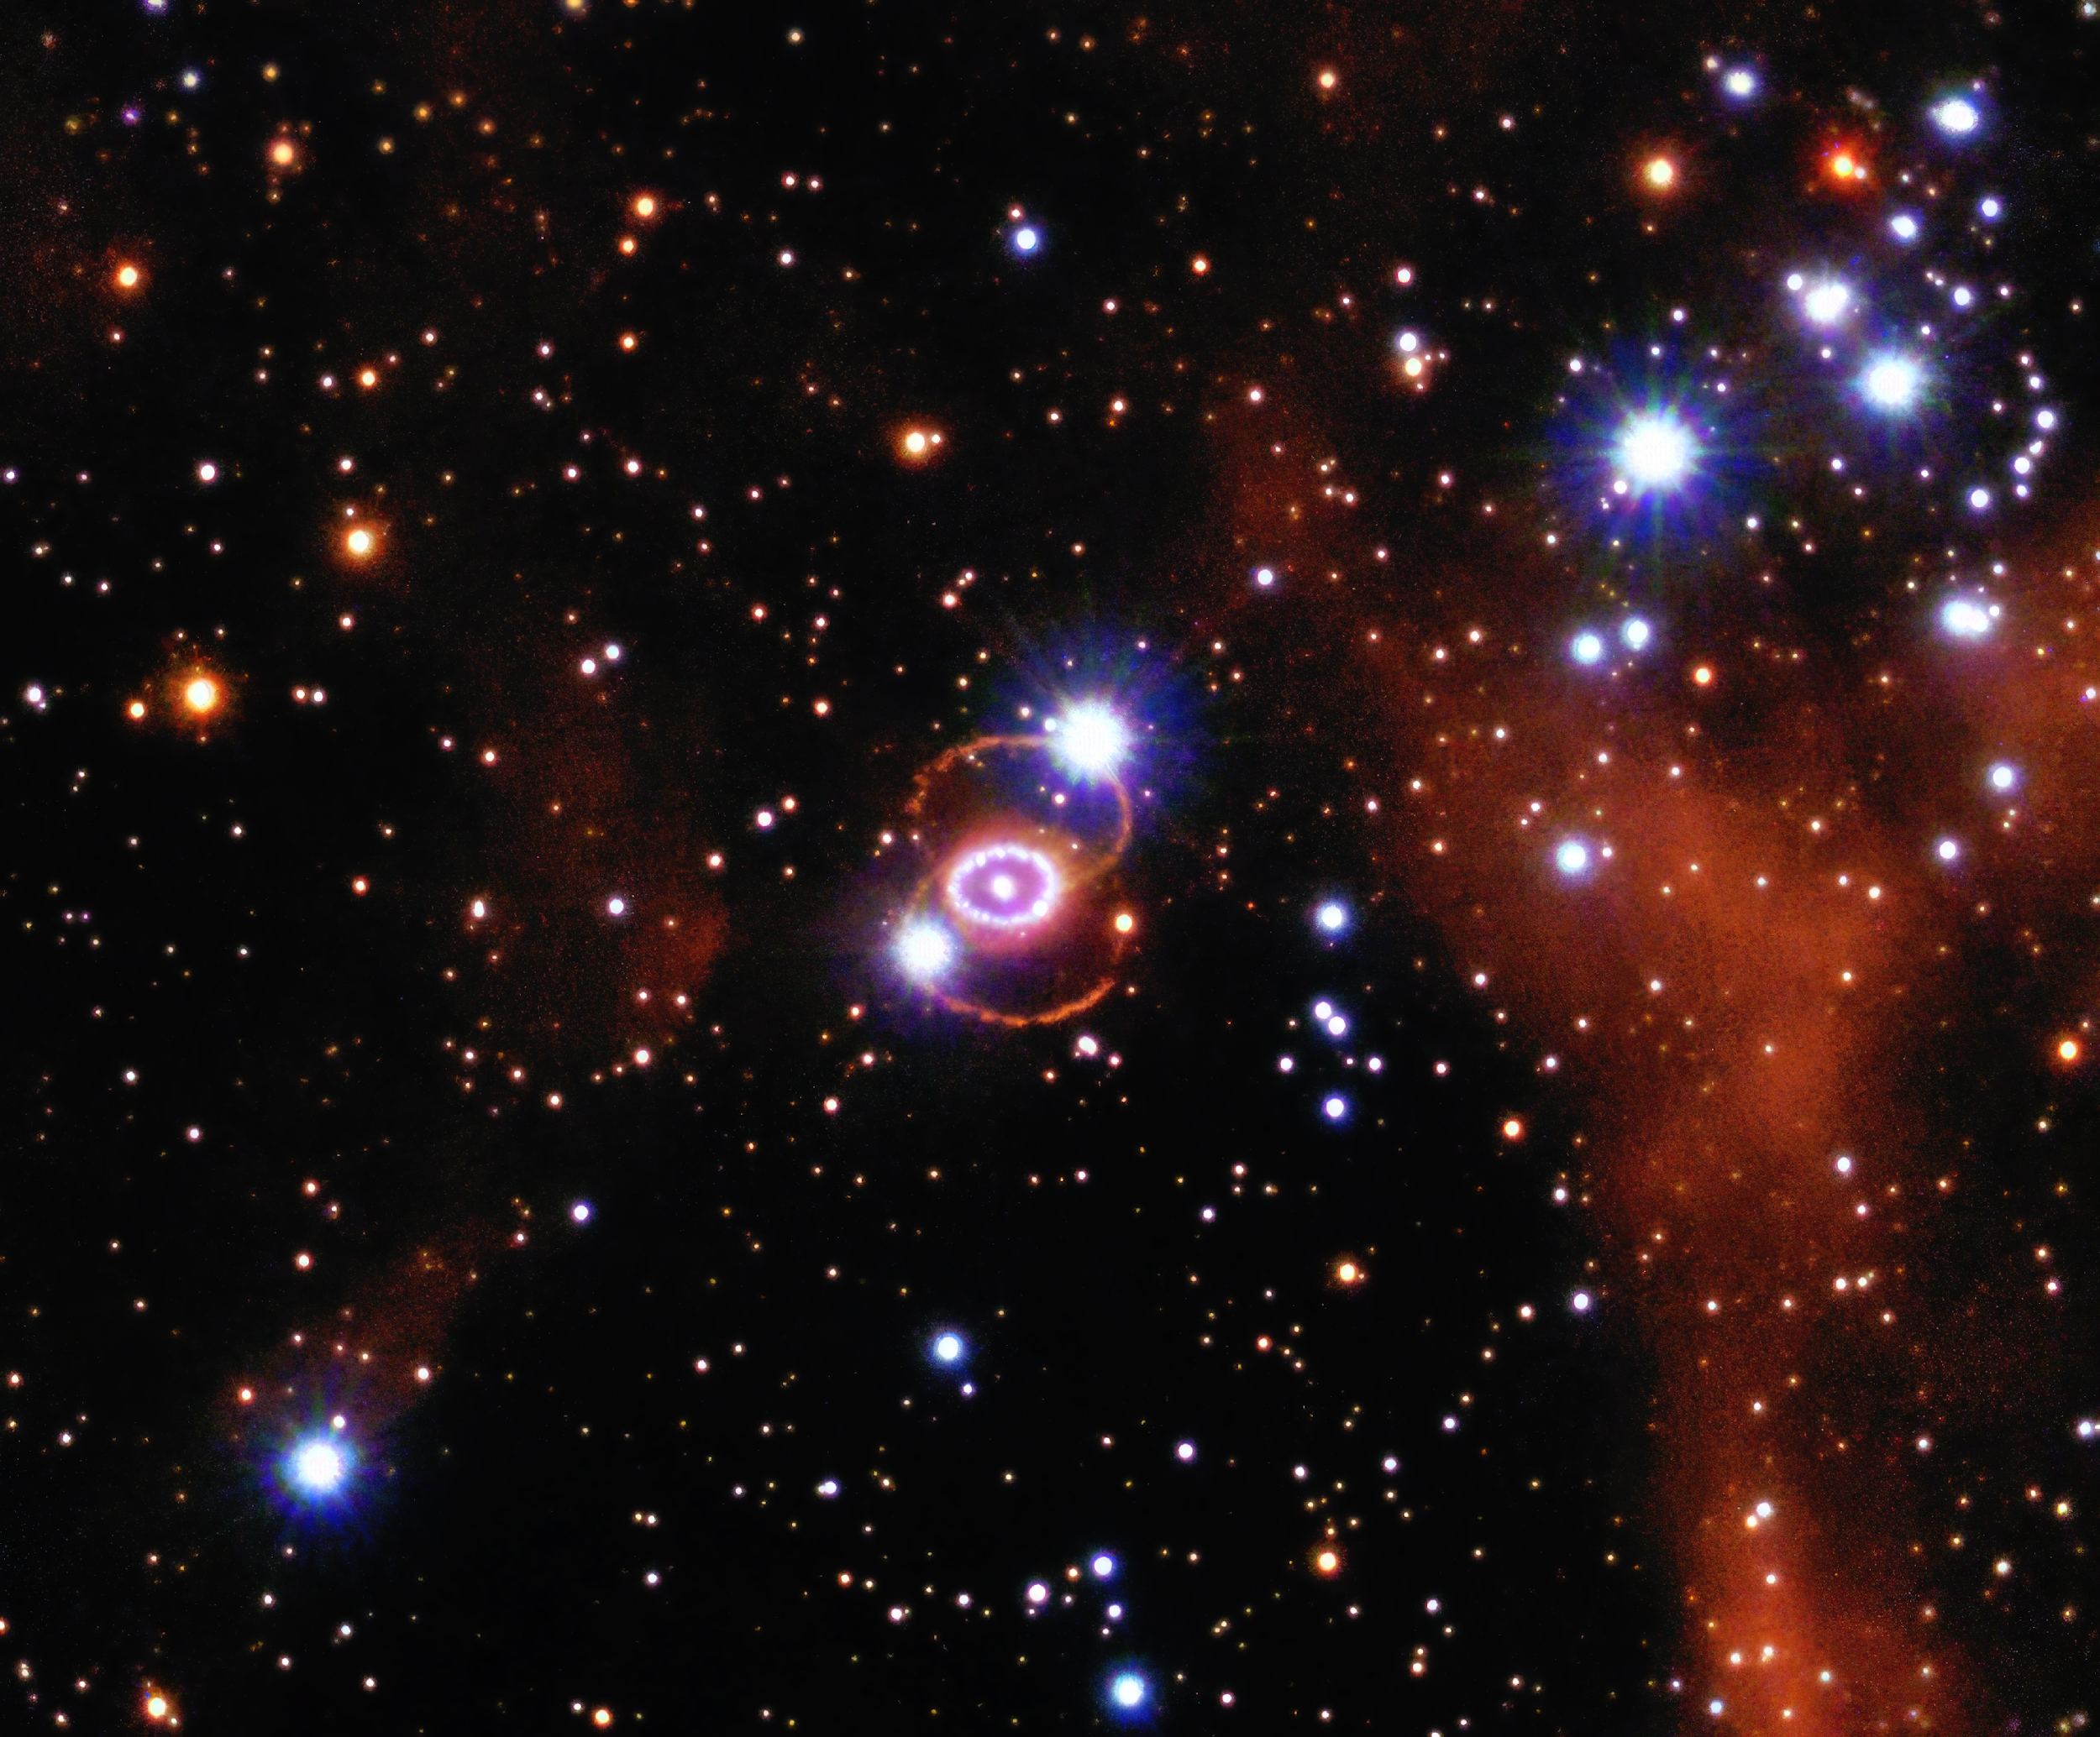
Thank you for listening!
Optical/IR imaging of Supernova SN 1987A. NASA/ESA/STSci. https://chandra.harvard.edu/photo/2024/25th/more.html
Notes:
We believe that we can harness the capabilities of AI to help us detect nearby black holes and its imperative that we do so. Thanks for listening!

Slide 12
Bibliography:
Xia, Heming, et al. "Improved deep learning techniques in gravitational-wave data analysis." Physical Review D 103.2 (2021): 024040.
Hezaveh, Yashar D., Laurence Perreault Levasseur, and Philip J. Marshall. "Fast automated analysis of strong gravitational lenses with convolutional neural networks." Nature 548.7669 (2017): 555-557.
Caltech. “What Are Gravitational Waves?” LIGO Lab, undated, www.ligo.caltech.edu/page/what-are-gw#:~:text=The%20strongest%20gravitational%20waves%20are. Accessed 29 Aug. 2024.
Lea, Robert. “Colliding Black Holes ‘Ring’ across Space-Time with Gravitational Wave Ripples.” Space.com, 21 Feb. 2023, www.space.com/black-hole-collisions-spacetime-ring-non-linear-effects. Accessed 29 Aug. 2024.
Sweeney, David, et al. "The Galactic underworld: the spatial distribution of compact remnants." Monthly Notices of the Royal Astronomical Society 516.4 (2022): 4971-4979.
Sweeney, David, et al. "Observing the galactic underworld: predicting photometry and astrometry from compact remnant microlensing events." Monthly Notices of the Royal Astronomical Society 531.2 (2024): 2433-2447.
Sahu, Kailash C., et al. "An isolated stellar-mass black hole detected through astrometric microlensing." The Astrophysical Journal 933.1 (2022): 83.
Lam, Casey Y., et al. "An isolated mass-gap black hole or neutron star detected with astrometric microlensing." The Astrophysical Journal Letters 933.1 (2022): L23.
Murray, Steve. “The LSST and Big Data Science.” Astronomy Magazine, 15 Dec. 2017, www.astronomy.com/science/the-lsst-and-big-data-science/. Accessed 29 Aug. 2024.

